Slide 1
Mid term report
Agi Koszorus
Promotor: Gerda Neyens
26.06.2017

Slide 2
Overview
Arenberg doctoral school
First year
Second year
Teaching duties
Timeline
Outlook

Slide 3
Arenberg doctoral school

Slide 4


Arenberg doctoral school
Compose supervisory committee
Blueprint doctoral training
Seminar scientific integrity
Teacher assistant training
Science communication and outreach
Mid term report
Academic English: writing and presentation skills

Slide 5
First year
Main project
Work @ CRIS

Slide 6
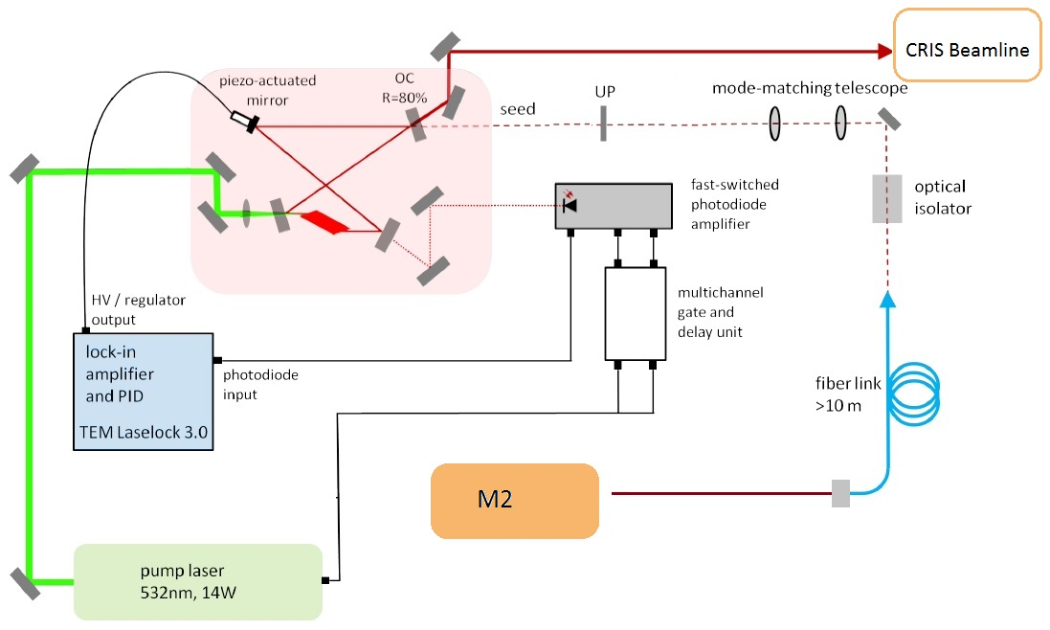
First year – main project
Pulsed Ti:sa ring cavity – slave laser
CW Ti:sa laser – master laser
High power pulses with spectral properties of the cw light
Efficient higher frequency generation

Slide 7
First year
Injection locked laser has been successfully used in the neutron-rich Cu and In experiment at CRIS
Working with Ti:sa and dye lasers at CRIS
Setting up for experiment
Maintenance
Higher harmonic generation
Basic knowledge of the beamline
First data analysis
Planning an experiment at CRIS

Slide 8
Second year
Main project
Preparations for In
Preparations for K
Data analysis

Slide 9
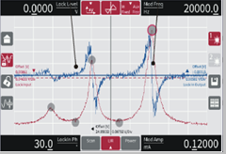
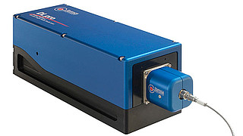
Second year
Stable frequency reference → Hyperfine transition
Spectroscopy of K or Rb
Diode laser
Vapor cell filled with K, Rb and Cs
Locking electronics
FPI (1 or more)
Wavemeter
Stable frequency reference

Slide 10

PBS
FPI 1 GHz
PBS
M
COSY
PD
Wavelength meter
λ/2
PD
M
M
M
FPI 620 MHz
FL
PD
PBS
PD
PD – photodiode
M – mirror
λ/2 – half-wave plate
PBS – polarising beam splitter cube
FL – fiber launch
– fiber
– laser beam
COSY – saturation spectroscopy module
50%
50%
10%
90%
M
M
DIODE LASER
λ/2
λ/2
experiment
M
Pockells cell
CW laser

Slide 11
In experiment
Offline test with the versatile ion source : Ablation of In
3 transitions offline
1064 nm ionizing step
tripled Ti:sa light as a scanning step (injection locked laser)
First online test of the laser stabilization system
1.
2.
3.
9²S_{1/2}
8²S_{1/2}
1. | 2. | 3.
Looking for HFS | Small structure | Very big HFS
Small HFS Overlapping peaks | Overlapping peaks | Unstable laser
⁴P_{5/2}
246 nm
246,8 nm
283 nm
²P_{3/2}
²P_{1/2}

Slide 12
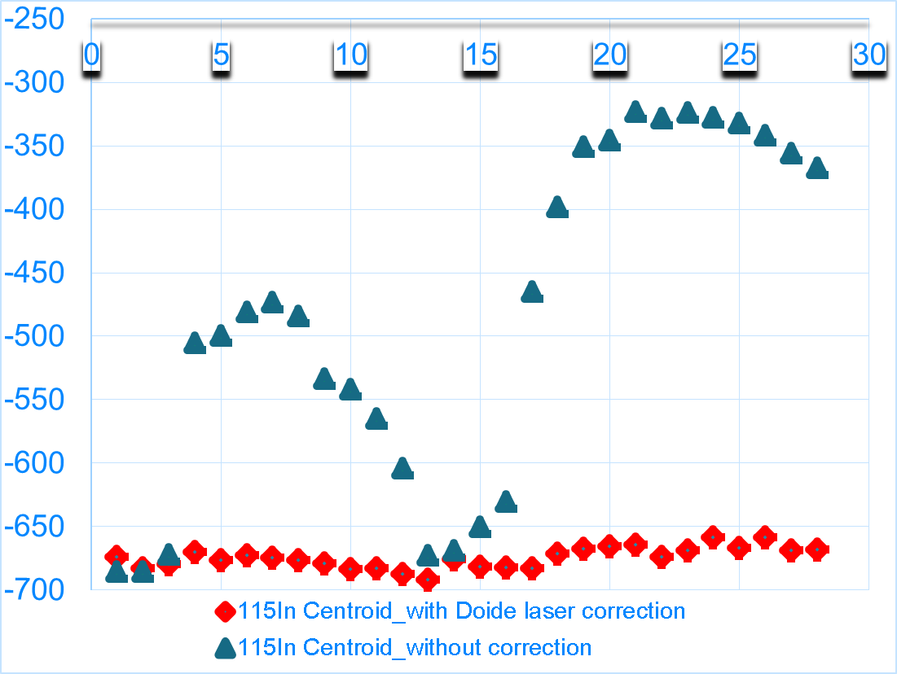
In experiment
2 transitions online
¹¹³⁻¹³¹In
Quadrupole and magnetic moments
Isotope shifts
High spin isomers
Laser stabilization test
400 MHz drift
Reduced to 50 MHz
(~15 MHz in fundamental)

Slide 13
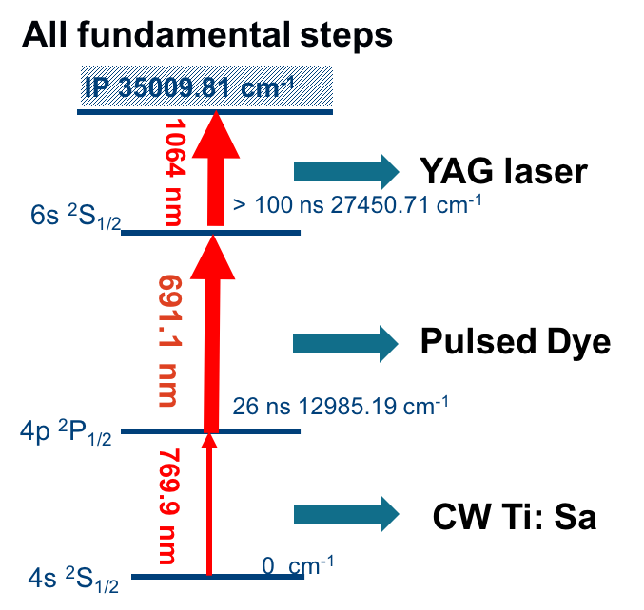
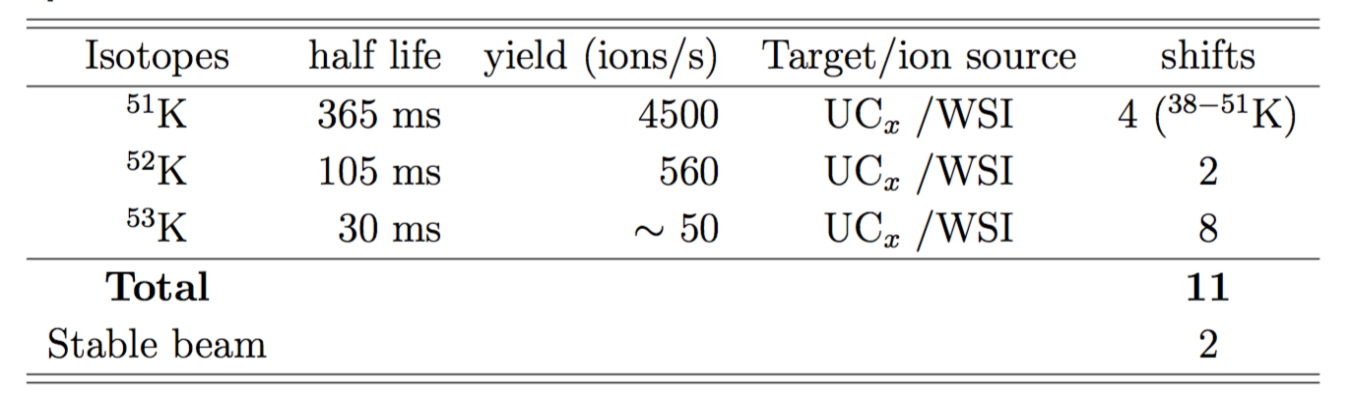
K experiment
IS620 ^{52,53}K
Spin, magnetic moment,
isotope shift
“Magic numbers” N=32,34

Slide 14
K experiment
MY INVOLVEMENT:
Setting up lasers
Laser stabilization
Offline test
Timing of laser pulses
Laser power
1 and 2 Pockels cells
Charge exchange efficiency
Saturation curves
Efficiency

Slide 15
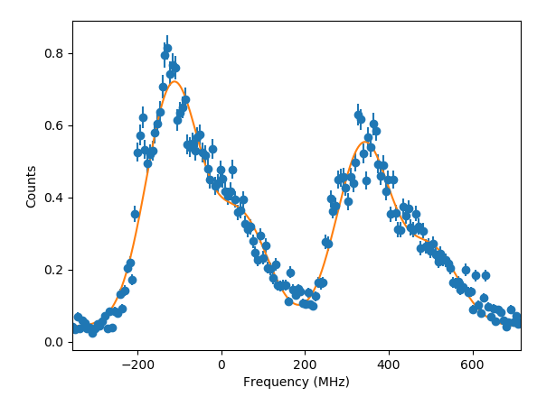
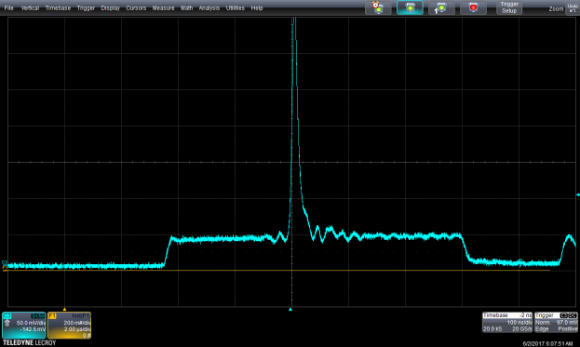
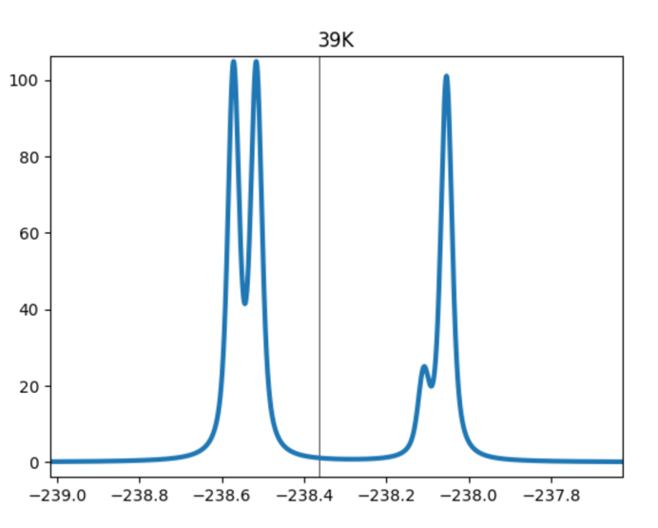
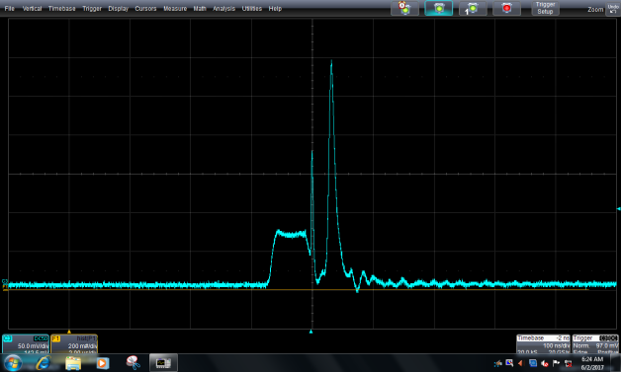
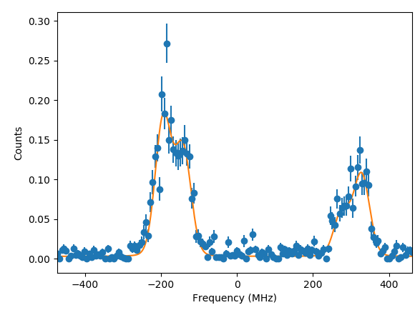
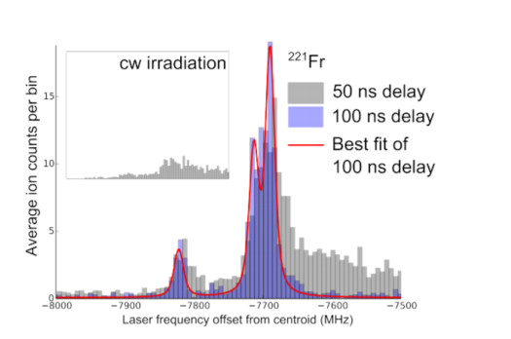
Offline tests
FWHM 153 MHz
Simulation of the hyperfine
Spectrum of ³⁹K (FWHM 40 MHz)
FWHM 47 MHz
Previous study of laser timings at CRIS
R. P. de Groote at al. PRL 2015

Slide 16
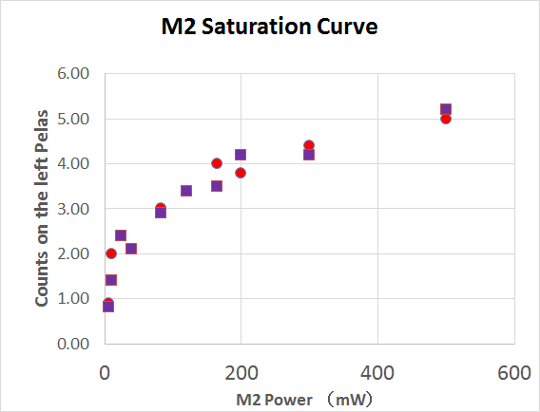
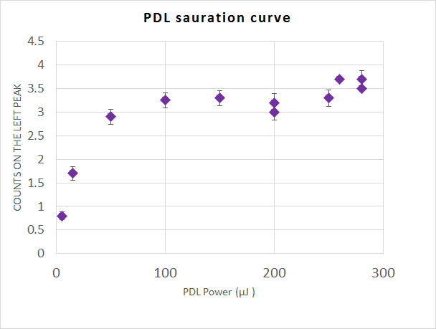
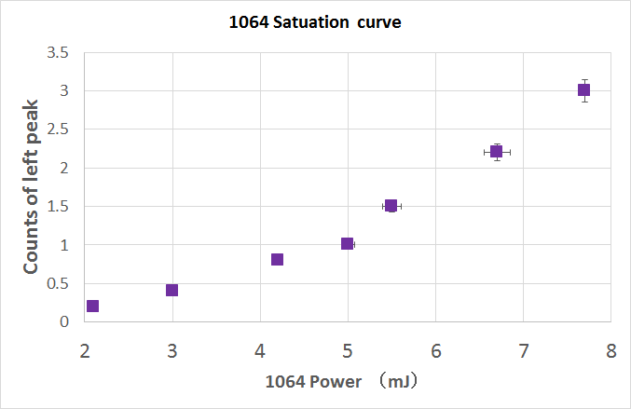
Offline tests
Saturation of transitions
1st step
2nd step
3rd step
3rd step power was 5-8 times higher during the experiment

Slide 17
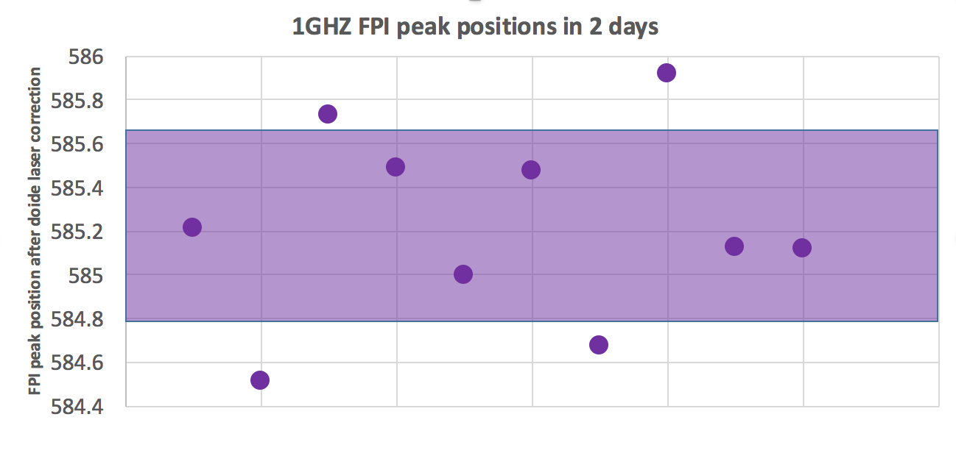
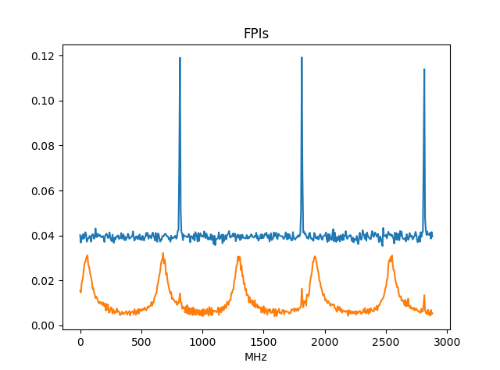
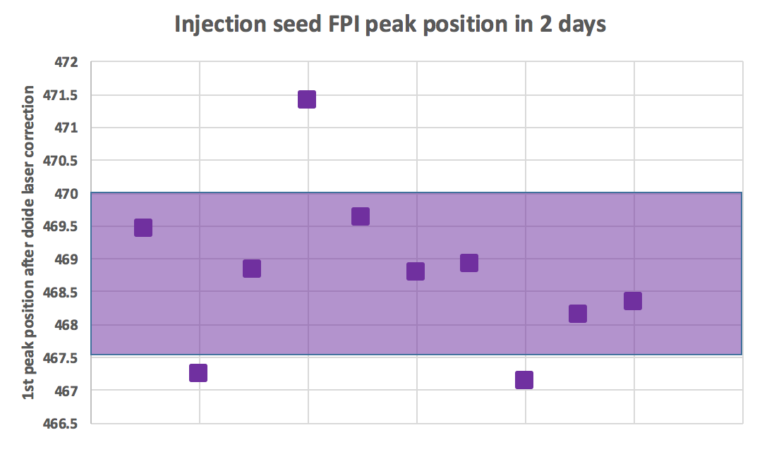
FPI for higher precision
1 GHz FPI
Injection locked laser
Standard deviation : 0.4410 MHz
Standard deviation : 1.2357 MHz

Slide 18
K experiment → online test
Experiment postponed due to bad target
Nothing shortlived, high contamination
38,39,40,41,42,43,44,45,46,47,48,49K
PLAN B
Online preparation for the K experiment at CRIS
Low resolution and high resolution measurements
Contamination, background
Stability of the system
Isotope shifts
line shapes

Slide 19
K experiment
Summary
Optimal laser timings for search mode and high resolution mode
Optimal laser power
Stable laser system
Reliable laser stabilization system
Offline efficiency 1 in 300
Online efficiency 1 in 500
No new results
Systematic studies

Slide 20
Data analysis
Data obtained in the neutron rich Ra experiment at CRIS
Offline data from the In test
K offline tests
K online test
In-depth study of the line shapes

Slide 21
Teaching duties

Slide 22
2nd year students
PIPS as charged particle detectors, Basic Experimental Techniques in Physics, Vincent Verelst and Sander Belmans, 2015-2016
3rd year students
Laser beam simulations through optical systems, Victor Vereet and Max Schonlank 2015-2016
Charge radii of Ra isotopes, Vincent Verelst and Matthias Rasschaert, 2016-2017
Master student
Laser spectroscopy of Ra isotopes, Dries De Maesschalck, 2016-2017

Slide 23
Timeline

Slide 24
Time line
This year:
Data analysis of the K offline and online test
ECT* Talent school
Preparation for the neutron deficient In and Sn
Ga experiment
Moving to CERN
In-depth study of the K and Sn regions
Theoretical background

Slide 25
Timeline
Next year:
K experiment
Data analysis
Publishing
Presenting our work at conferences
2019:
Start writing my thesis

